Slide 1
Choosing Media

Slide 2
INTRODUCTION
There are a variety of different digital media available to teachers. It is important to identify these media, analyse their characteristics and discuss which media is appropriate

Slide 3
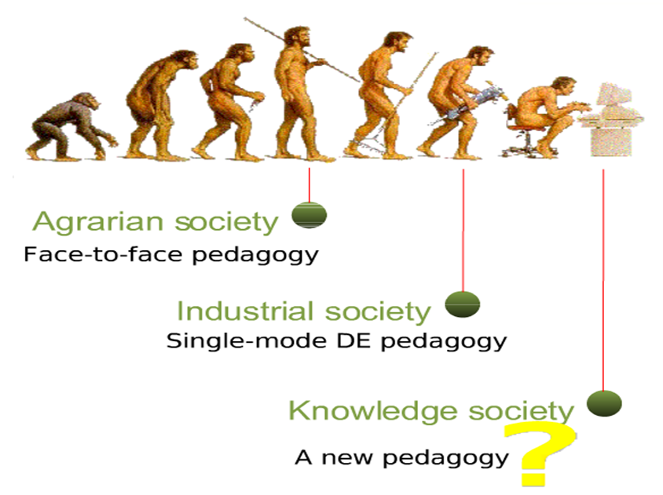
THE HISTORY OF EDUCATIONAL MEDIA AND TECHNOLOGY

Slide 4
About 3000 years ago – 4th Century: Face to face interactions between teachers and learners
14th century: Invention of the printing press, there was improved availability of printed matter thus more people became literate with professionals in government, commerce, medicine and law. It was possible to write down knowledge and this caused an explosion of ideas
20th century: The postal service and telephone which contributed to the development of correspondence education. In 1924 radio was introduced which led to adult education broadcasts leading to the first schools radio starting at 1926.
1930s: The birth of the motion picture and the 16mm film which was used extensively in schools. This was replaced in the late 1950s with educational broadcasting on television.
late 1960s to date: Computers were born. After 1980s, rapid growth in technologies that are now used for teaching.

Slide 5
ACTIONS Model

Slide 6
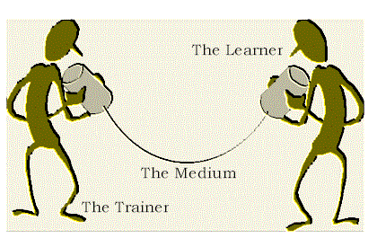
Media is just a channel

Slide 7
Teachers will need to consider the use of the most appropriate media for different elements of course content. This will ensure that they benefit from varying characteristics of the new technologies and thus Improve the teaching and learning experience making it more interesting for both teachers and learners

Slide 8
The ACTIONS model developed by Tony Bates provides a framework for selecting e-technology. 7 considerations that experts, educators and designers should use in choosing the proper technology for delivering distance education courses are provided.

Slide 9
'ACTIONS' is the acronym for the seven main criteria that Bates proposes for selecting a learning technology: access, cost, teaching and learning implications, interaction, organisational issues, novelty and speed.

Slide 10
1. ACCESS (A):
It is important for the teacher to consider how accessible is a particular technology for learners and how flexible is it for a particular target group. It is important for one to ask where the learners will study from (home, workplace, outreach centres, on campus, travelling etc) and whether they have the means to access the particular technology

Slide 11
2. COSTS (C):
You will consider the costs of each structure of technology and the unit cost per student plus the opportunity costs of using a particular technology compared to other technology choices. It is imperative that the teacher performs a cost benefit analysis of the technology

Slide 12
3. TEACHING AND LEARNING (T):
The teacher will consider the kind of learning needed and what instructional approaches will best meet these needs. Considerations will be made for the best technologies supporting teaching and learning in a particular environment and whether the content can be adapted to the technology.

Slide 13
4. INTERACTIVITY AND USER FRIENDLINESS (I):
The teacher will need to be clear on what kind of interaction that a particular technology enables and how easy it is to use and learn considering feedback mechanisms too.

Slide 14
5. ORGANISATIONAL ISSUES (O):
Consideration will be made for what organisation and institutional requirements to provide stability and support (Students, Administration systems, funding for resources, staff training, staff contracts and job descriptions etc). Consideration must be made on the barriers that the teacher may face in using this technology successfully within the institution and what changes need to be made within the organization to incorporate the technology

Slide 15
6. NOVELTY (N):
Consideration is made on how new the technology is and what are its technical capabilities and robustness.

Slide 16
7. SPEED (S):
One will need to determine how quickly can the course be created and distributed within this technology and how quickly can the materials be changed.

Slide 17
COMPARING DIFFERENT MEDIA
FACE TO FACE / HUMAN MEDIA
This means any activities taking place with teachers and learners at the same time but not necessarily in the same place (although they could be!). It could involve lots of different face-to-face teaching methods (Lecture, Demonstration, Group work, Question and answer, Practicals, Experiments, Tests, Worksheet sessions) but also through ICT e.g computer discussion forums, computer chat sessions, telephone tutoring, video conferencing and mlearning – using PDAs or mobile phones to deliver content and keep in touch with learners

Slide 18
Strengths | Weaknesses
interactive & flexible | limited to small numbers
no special equipment needed | constrained by the physical facilities – classrooms, workshops, laboratories
relies totally on the teachers’ skills | relies totally on the teachers’ skills
everyone understands it | pacing is for the group not the individual
 | expensive if large numbers (teachers’/tutors salaries, classrooms)

Slide 19
Situations when face to face is good
explaining complex topics and coaching learners
demonstration
practical sessions
responding to learners’ needs immediately
supporting learners
a lead medium
collaborative working

Slide 20
TEXT
This involves any activities where we write down what we want learners to learn and/or do. This could involve lots of different teaching methods such as:
Self-instructional materials
Tutorial in print - (Lecture)
Group work
Question and answer
Experiments
Tests
Worksheets
handouts
includes photographs, graphics and illustrations

Slide 21
Strengths | Limitations
everyone understands it | relies on literacy – some learners may prefer other media
easy to use | needs photocopy/printing facilities and resources
easy to produce | takes time to produce and needs layout and graphics skills
learner has control
some interactivity
can accommodate large numbers
Cost-effective in large numbers

Slide 22
Text is good for
a lead medium –(this the primary medium)
covering large amounts of theoretical content
complex diagrams and illustrations
links to other media for maps, charts, posters
integrating with other media – such as video

Slide 23
AUDIO
Audio media consists of any materials which are delivered by sound. They are in different forms and include:
Audio, audio-vision, radio and podcast
Radio broadcast over airwaves – usually by national broadcaster or community or campus radio station. We now also have radio accessible over the internet
Audio delivered by personal equipment – used to be audio cassette, now more likely to be MP3 players or CDs
Audio-vision where some special visuals go with audio commentary – very useful in distance education
Podcast – the latest form of audio narrowcasting – radio magazine programmes or special interviews which you can listen to on the internet or download to your MP3 player
Screen readers/ ebook readers

Slide 24
Strengths
most people are familiar with it
oral culture in Africa
can incorporate music and other sounds
flexible delivery - can be delivered by computer, audio cassette, MP3 player, radio
can accommodate large numbers

Slide 25
Weaknesses
one-way; not interactive unless linked to ICT
needs specific equipment
relies on power supply

Slide 26
This media is good for:
student support – magazine programme
interviews with experts – or learners
edutainment - drama
integrating with print or face to face
recording short explanations
clarification of a concept
suggestions / tips about the course and content
instructor experiences / reflections about the content
student presentations / reflections / record of events
improving students' communication skills (vocabulary, writing, speaking, presentation)
peer review for students
oral histories
oral guides for museums, art galleries, historical tourist areas, etc

Slide 27
VIDEO
This is the use of any material which involves sound and moving pictures and/or graphics. It may be delivered on a videotape, DVD/CD or may be downloaded via the internet as streaming video

Slide 28
Strengths
familiar to most learners
learner controls pace of delivery
enables learners to review material as often as they want
saves teaching time as lecturer does not have to repeat the demonstration
can accommodate large numbers
Allows the presentation of demonstrations and processes – good for animation

Slide 29
Weaknesses
not familiar to all
one-way – not interactive
teacher needs special skills
needs expensive, specialist equipment
relies on power supply
takes time to plan and develop

Slide 30
This media is good for:
edutainment - drama
anything that needs moving pictures
showing things – demonstrations
simulations and models
integrating with print or face to face

Slide 31
ELEARNING
This defines any activity in which learners use computers and communications technology as part of their learning. It may include:
Online learning
Learning from a CD or DVD
Could be text, audio, video, simulation, quiz etc
Discussion
Quizzes, tests, assignments
Pinboards or bulletin boards
Chat
Wikis
Group work
Shared documents – see Google documents www.docs.google.com
Shared websites – see Google sites - sites.google.com

Slide 32
Strengths
interactive & flexible
can accommodate large numbers
allows synchronous and asynchronous communication
enables collaborative working
learner controls pace of delivery and pathway through material

Slide 33
Weaknesses
teacher needs special skills and software
learners need special ICT and study skills
learners need access to ICT
expensive to develop (time)
relies on power supply

Slide 34
This media is good for
using multimedia including audio and video and animations
explaining complex topics
different pathways through course content
making a wide range of resources available
supporting learners
collaborative working
motivating learners

Slide 35
testing and assessment
simulations and models
learners who take longer to grasp content and need to review material several times
learners who catch on very quickly and can move on

Slide 36
Preparation of handouts
Qualities of a good text book
Use of text books
Audio and video development

